Slide 1
Know Your Device
Muhammad Ilham Pratama
5220600042

Slide 2
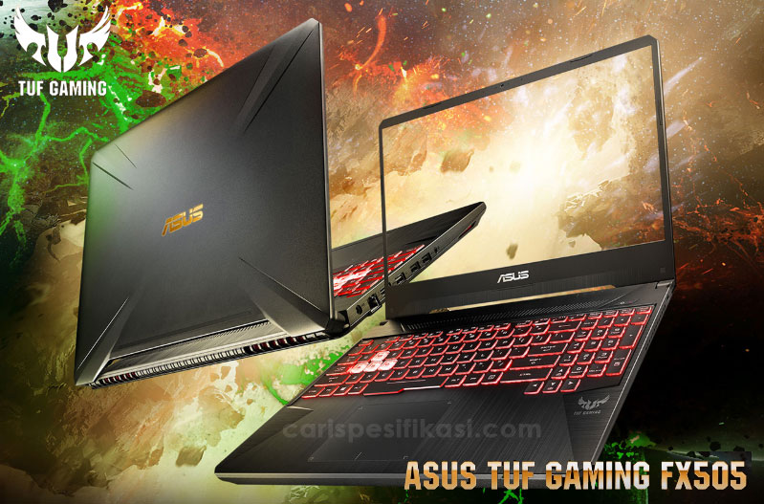
Tampilan Laptop

Slide 3
Spesifikasi Laptop
/01
Nama Seri
/02
CPU BITS
/03
CPU Manufactures
/04
CPU Models
Asus Tuff Gaming
fx505DD
64 Bits (X64)
AMD
(Advanced Micro Devices)
AMD Ryzen 5 3550H

Slide 4
Spesifikasi Laptop
/05
Ram Size
/06
VGA & GPU Models
/07
Hardishk Type
2 Slot
16 GB Speed 2400Hz
NVIDIA Geforce GGTX 1050 3GB & AMD Radeon Vega 8 Graphics 512 mb
SSD 512 GB & HDD 512 GB

Slide 5
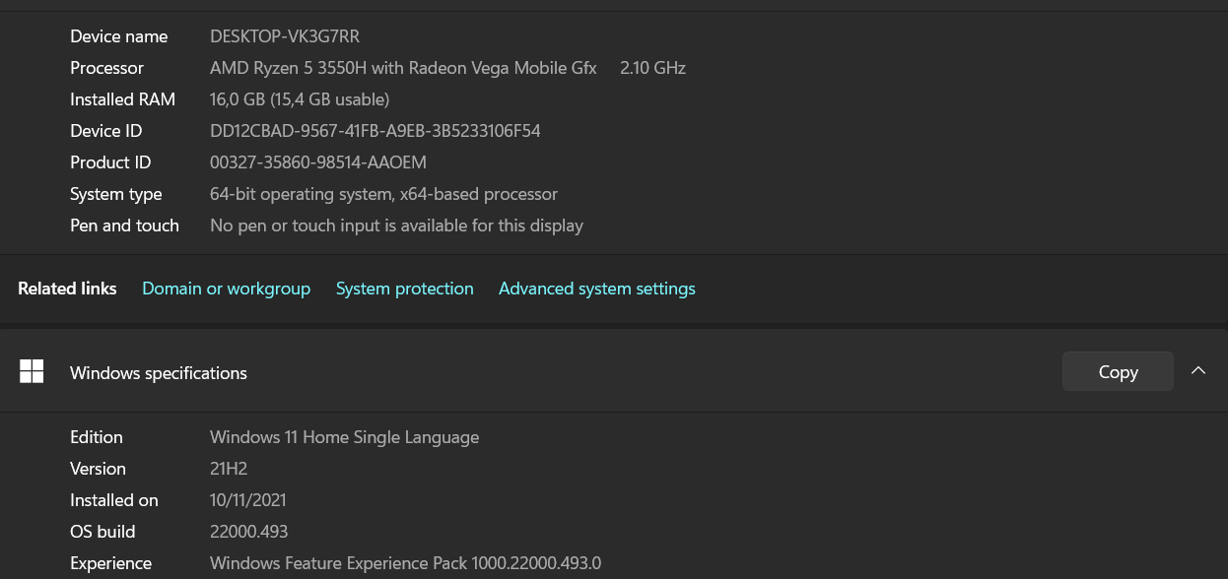
Screenshoot Spesifikasi Laptop

Slide 6
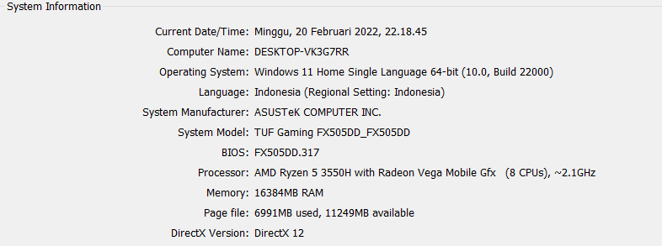
Screenshoot Spesifikasi Laptop

Slide 7
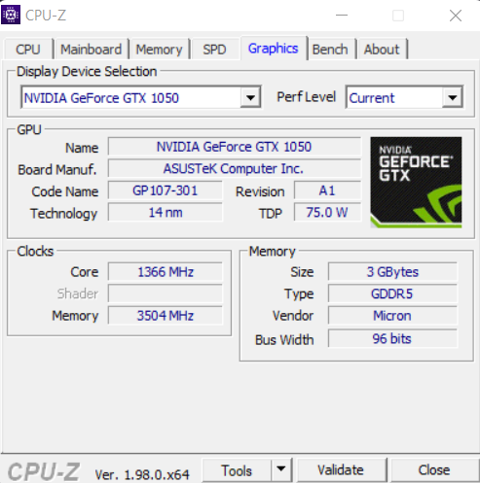
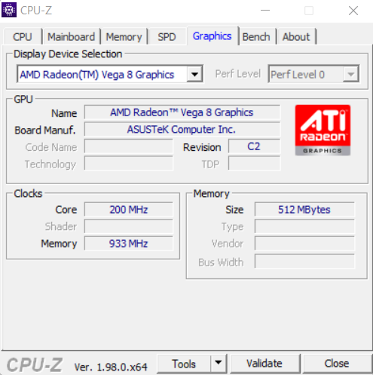
Screenshoot Spesifikasi Laptop

Slide 8
Terima Kasih
YOUR LOGO HERE
INDEX.HTML

